Slide 1


GovState
transfer
EXPERIENCE

Slide 2

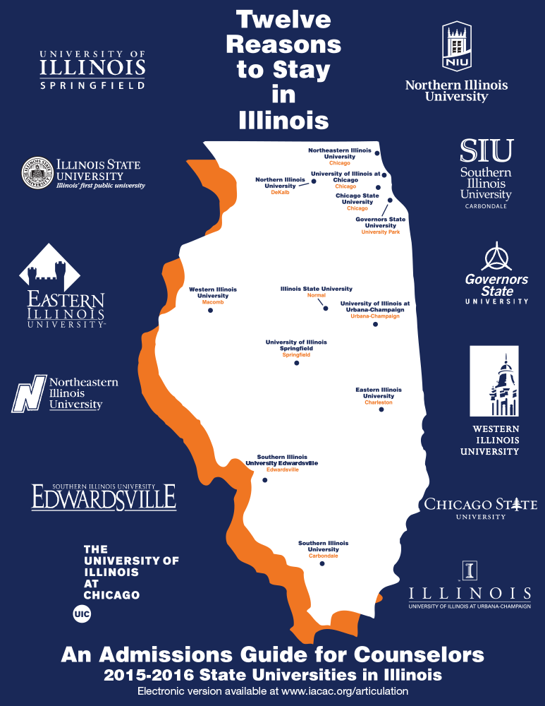
GovState Quick Facts
- Founded in 1969
- 4,427 Students Enrolled
- 12:1 Student-Faculty Ratio
- 49,000 alumni
- 42.6% of Undergraduates are First Generation College Students
- 25 countries represented in our student body

Slide 3
Find the right program for YOU!
College of Arts and Sciences
16 programs, 23 minors
College of Education and Human Development
3 programs, 3 minors
College of Business
5 programs, 8 minors
College of Health and Human Services
7 programs, 2 minors

Slide 4

What’s New @ GOVSTATE?
First Generation Center – opened in Fall 2023; support center focused on providing extra resources to succeed in their educational journey
Latinx Resource Center - opened in Spring 2024; serving Latinx students by supporting, appreciating and culturally representing on GovState’s campus
Social Justice Initiative (Legal Clinic) – opened Summer 2023; provides free self-help legal assistance and non-legal resources to low-income Illinois residents
Greek Life – Alpha Kappa Alpha Sorority, Incorporated was the first divine nine organization to cross on GovState campus in November 2023; more to come…

Slide 5



Get Involved!
Student Clubs and Organizations
Sports Teams
Student Senate
On-campus Employment
Honors Societies
Program Counsels
Student Ambassadors
Leadership Development

Slide 6
Benefits of being involved on campus
Practical Transferable Skills
- Event planning
- Delegating
- Leadership
- Fundraising
- Collaborating
- Marketing
Letters of Recommendation or References
The more you are involved the easier it is for people to advocate for and support you after college.

Slide 7

Become a Jaguar!
NAIA Collegiate Teams
-Men’s and Women’s Basketball
-Men’s and Women’s Cross Country & Track
-Men’s and Women’s Golf
-Men’s and Women’s Soccer
-Women’s Volleyball
-Women’s Bowling
Men’s Basketball
-2018 Conference Champions
-Conference Tournament Champions
-Earned 1st ever bid to NAIA National Tournament
Women’s Basketball
- Earned 1st ever bid to NAIA National Tournament

Slide 8

Admission Requirements
- 24 semester hours of college coursework
- 2.0+ cumulative GPA*
- Good standing at previously attended institution
*Education, Health Administration, and Social Work have special requirements.

Slide 9
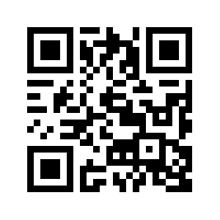
How to Apply
Complete an application today, or online at: apply.govst.edu/apply
You can also apply via the Common App (Freshman and Transfer)
$25 application fee – currently waived for Undergraduate Students!
Submit all Official Transcripts to: apotranscripts@govst.edu
Check for additional admission requirements
Examples: Social Work requires two Letters of Recommendation; Nursing requires RN Licensure.

Slide 10
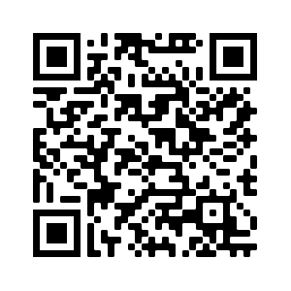
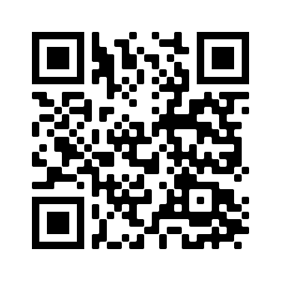
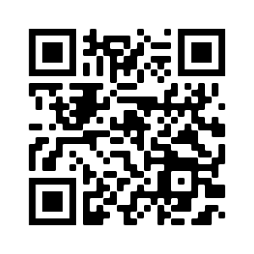
Transfer Student Resources
Jaguar Transfer Credit Evaluator
The Jaguar Transfer Credit Evaluator is a tool to help transfer students see how their previous college coursework and exams contribute to their degree at GovState! The process is quick, easy, and even provides next steps for transferring.
Transfer Guides
GovState has agreements with many area community colleges that help ensure the proper transfer of courses
Transfer Thursdays
During Transfer Thursday, you will have the opportunity to receive an on-the-spot admissions decision! You will first complete the online application prior to Transfer Thursday, then on the day of, you will come to GovState with all official transcripts from all previously attended institutions.

Slide 11
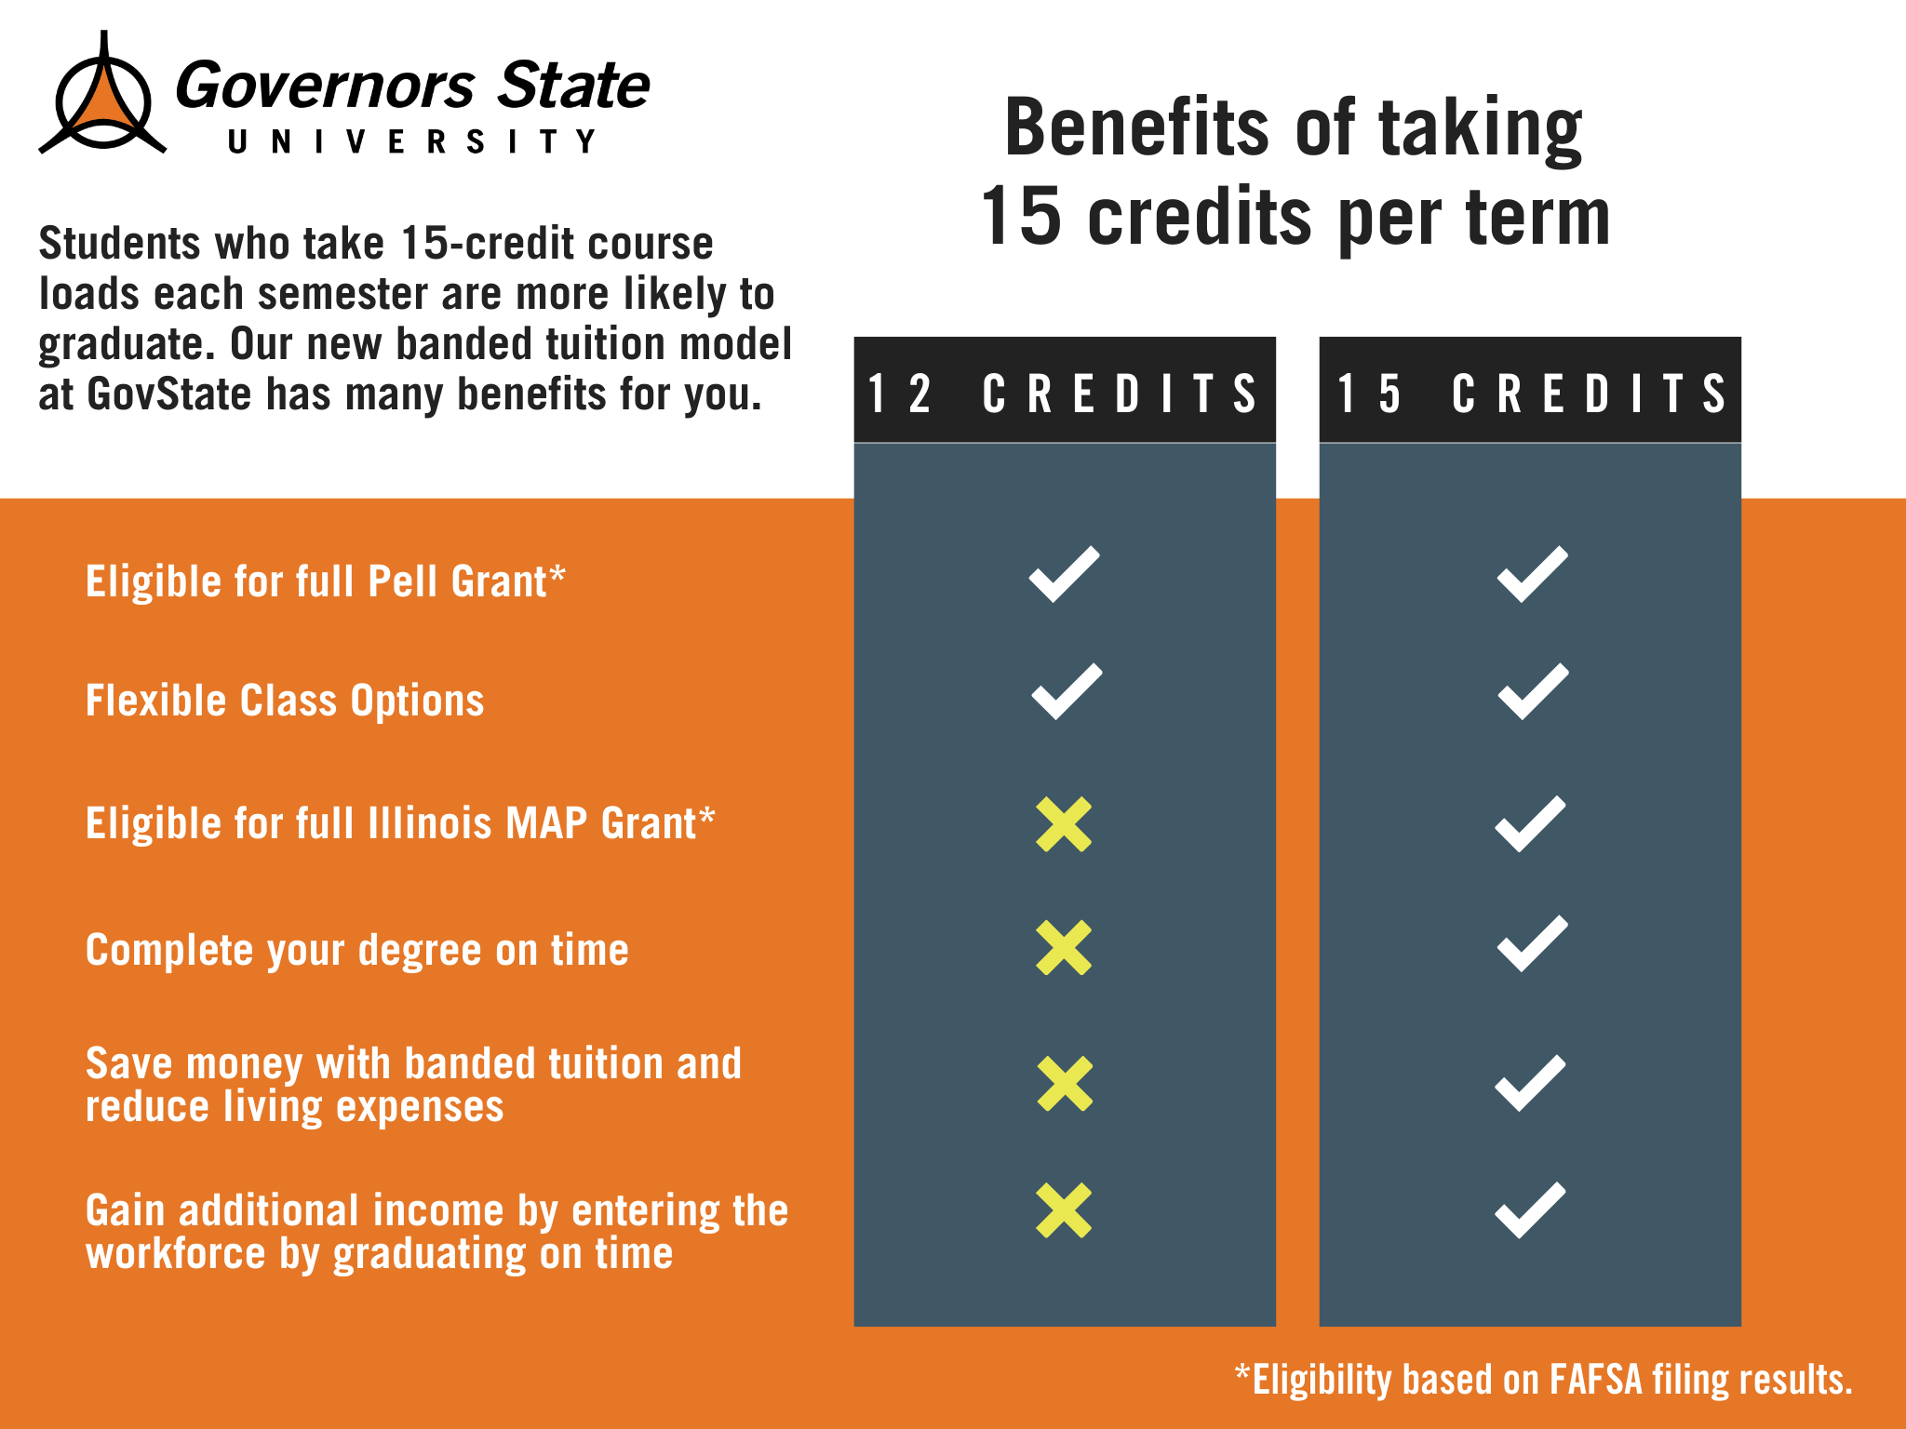
New for 24-25- Banded Tuition
All new students will be charged banded tuition starting in Fall 2024.
Allows students to be charged the same tuition if you are taking 12 credit hours or more!

Slide 12
Tuition and Fees
26-27
 | GovState Cost
Part-Time | $380 per credit hour
Full-Time | $5,477 per semester

Slide 13

Office of Admissions
Phone: (708) 534-4490
Email: admission@govst.edu
Website: www.govst.edu/admissions

Slide 14


Ways to Connect to Admissions
Direct Line: 708-534-4490
Bailie Antwiler:
bantwiler@govst.edu
708-235-6841
Stephanie Maltos:
smaltos@govst.edu
708-235-7161
Direct Link: www.govst.edu/admissions/
Spanish Language Virtual Appointments Available

Slide 15


Slide 16



Slide 17
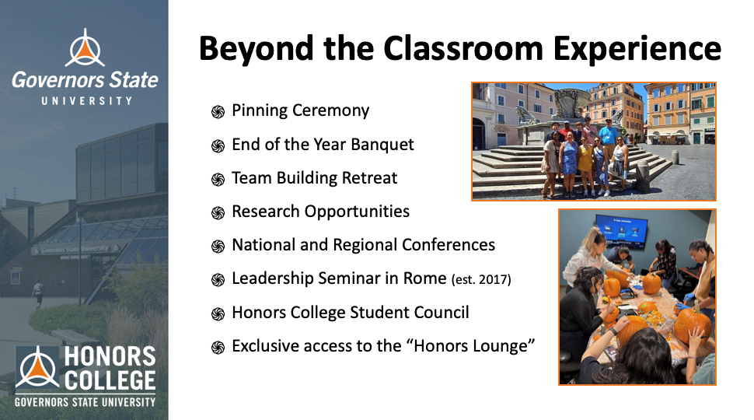

Slide 18
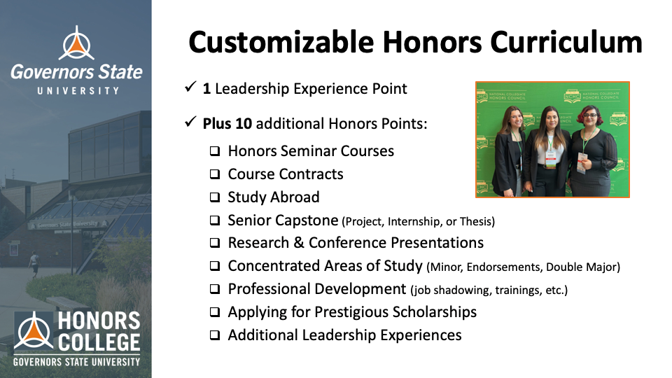

Slide 19
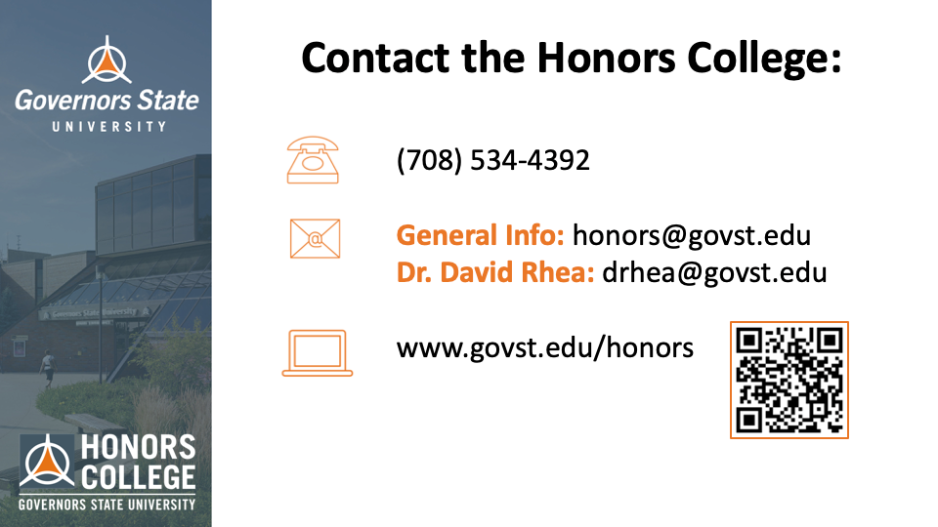

Slide 20


Slide 21


Slide 22


Slide 23
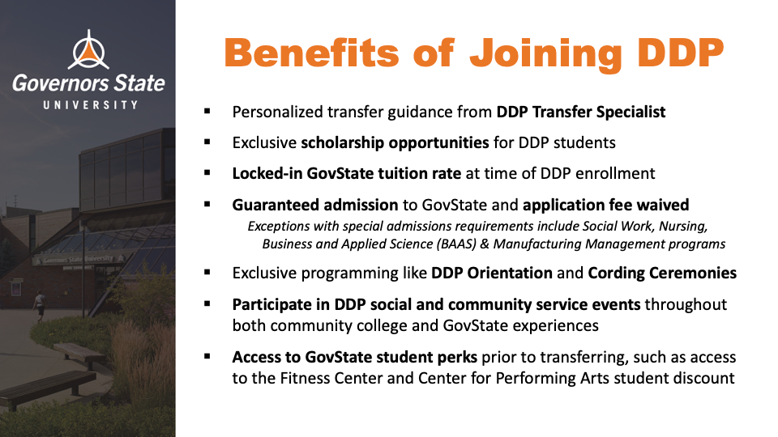

Slide 24
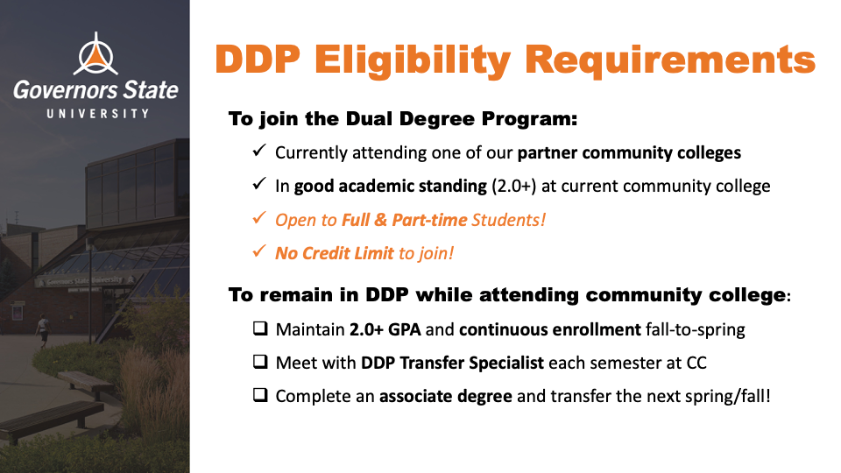

Slide 25
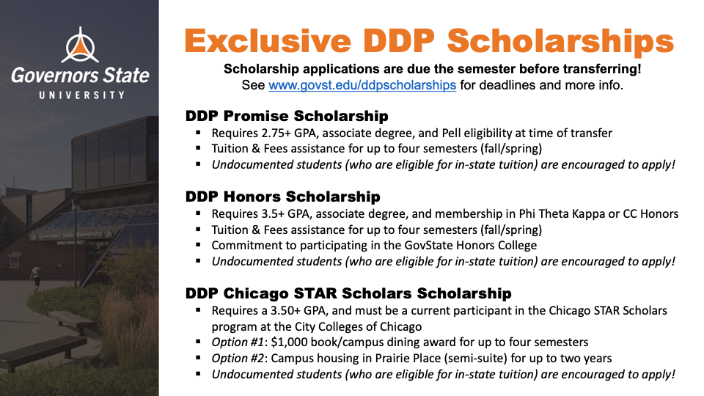

Slide 26


Slide 27

FINANCIAL AID FOR
TRANSFER STUDENTS

Slide 28
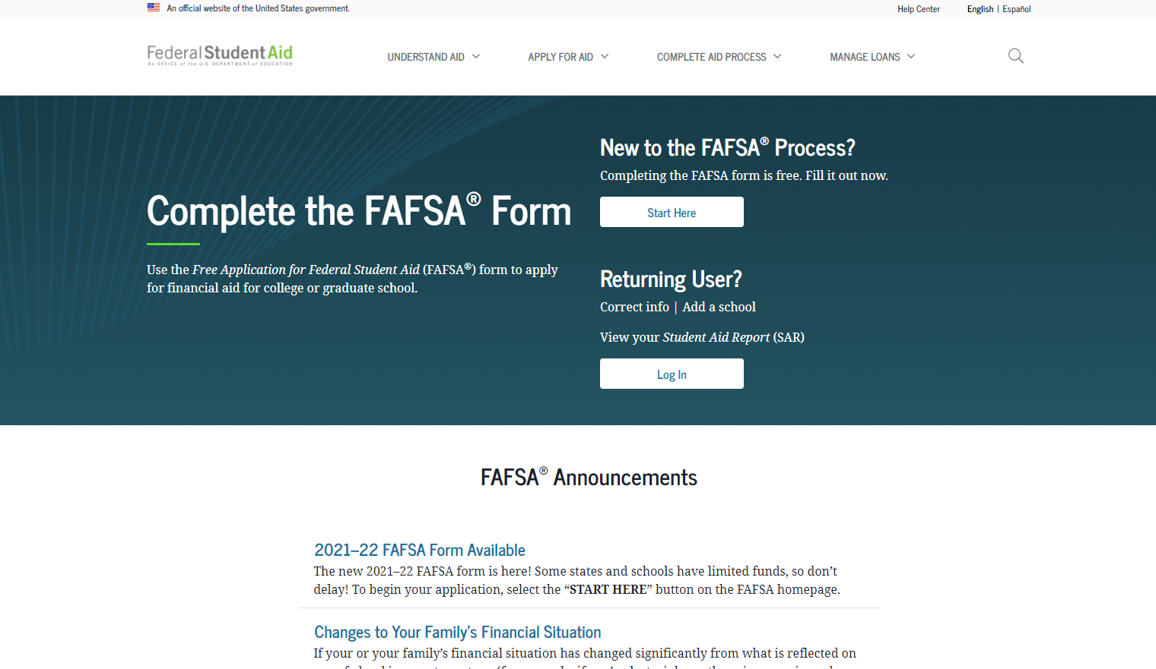
How Do I Apply for Financial Aid?
Have you done the #FAFSA?
Free Application for Federal Student Aid
Found online at studentaid.gov
Direct Link: (https://studentaid.gov/h/apply-for-aid/fafsa)
Update for 25/26 FAFSA

Slide 29

Types of Financial Aid
1. Grants
2. Loans
3. Scholarships
4. Student Employment Opportunities

Slide 30


Types of Grants
Federal PELL Grant
Illinois MAP Grant
Federal SEOG Grant
TEACH Grant

Slide 31

Student Loans
1. Federal Direct Loans*
-Subsidized
-Unsubsidized
-Parent PLUS
2. Private Student Loans
*Students must be enrolled in at least half-time (6 credit hours) status with Financial Aid eligible coursework to qualify for Federal loans.

Slide 32
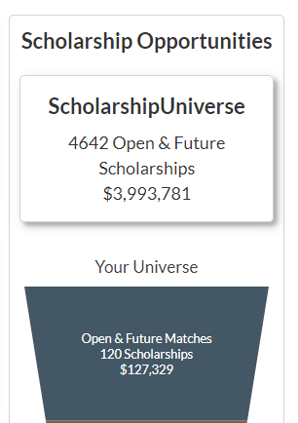
Scholarships
GovState Scholarship homepage: www.govst.edu/Scholarships/
Scholarship Universe: www.govst.scholarshipuniverse.com/public
With Scholarship Universe, Students will be able to:
Answer questions and match to scholarship opportunities they are eligible for
The more you answer, the more scholarships you match to
Easily apply online to multiple scholarship opportunities through a personalized portal
See scholarship metrics to determine their chances and effort required to apply
Be alerted whenever they are matched to new scholarship opportunities
GovState and external scholarships
All vetted = no questioning if the scholarship is legit

Slide 33

Federal Work Study
Allows students to earn money to help pay for educational expenses
Employment on or off-campus
Minimum wage or higher
Gain valuable work experience
Great networking experience
FAFSA is required
https://www.govst.edu/work-study/ https://www.govst.edu/employment-resources
Notes:
FWS is a government allotment to work on campus up to the amount on their award letter
All jobs pay $15 an hour or more
These are typically assistant-type roles (answering phones, emails, etc)
I always mention during down-time they can typically get their HW done
Gain work experience and get to explore different areas within the university
Talk about that’s how you got your job here ☺

Slide 34
AIM HIGH – Transfer Students
Guaranteed Transfer Scholarships for up to $5000 per year
No application necessary!
Must have earned an associates degree at a community college or transfer from another 4-year institution.
Renewable for 4 semesters.
Full criteria available online based on your entry term
govst.edu/aimhigh-transfer/

Slide 35
Office of Financial Aid
Phone: (708) 534-4480
Email: faid@govst.edu
Website: www.govst.edu/financialaid

Slide 36
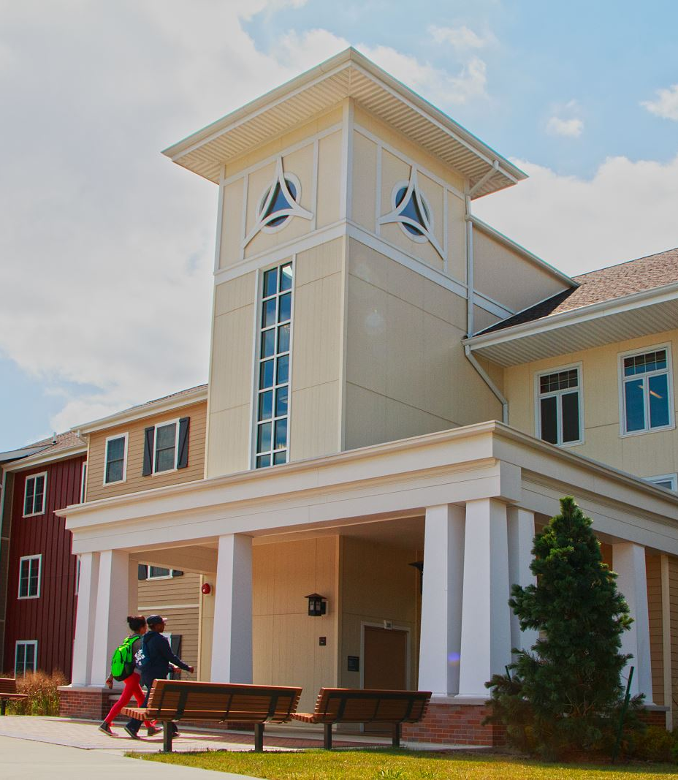
BREAKOUT SESSIONS Housing
Engbretson Hall
Campus Resources
Hall of Honors
Life on Campus (Student Life)
Sherman Hall

